Slide 1
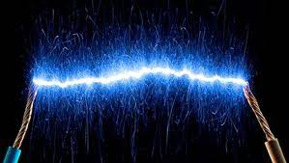
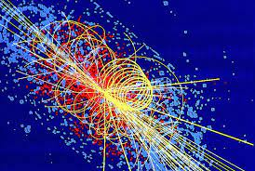
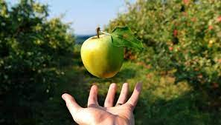
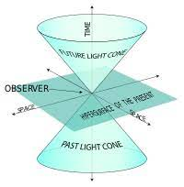
A-level Physics Induction
Welcome!

Slide 2
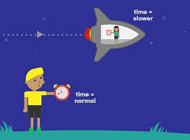
Quick Challenge!
I am on a spaceship travelling at the speed of light. I shine a torch out of the front of the spaceship. How fast do I measure the light waves to be going? How fast does someone stood on Earth watching all of this measure the light waves to be going?
More on this at the end of year 13!!!!!!

Slide 3
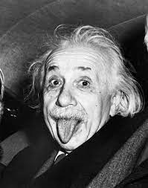
Today’s Session
Why Physics?
Options beyond LSST and A level
Course Structure
Transition for GCSE to A level
Summer Preparations
Resources

Slide 4
Why Physics?
What A-levels have you chosen?
What do you want to do?
Why have you chosen Physics?
Notes:
On WB?

Slide 5
Physics and Beyond at LSST
What courses are you interested in?
Courses our students have gone on to do:
Physics
Mathematics
Economics
Engineering
Philosophy
Chemistry
And loads more….!
Medicine
Computing

Slide 6
Physics and Beyond at LSST
Possible careers with a Physics degree:
Nuclear energy
Any thoughts on what you want to do?
Research
Education
Engineer
Medical research
Economist
Meteorologist
And loads more….!
Doctor
Civil service
Accountant

Slide 7
Course Outline
Particles and radiation: This section introduces students both to the fundamental properties of matter, and to electromagnetic radiation and quantum phenomena.
Waves: Development of knowledge of the characteristics, properties, and applications of travelling waves and stationary waves. Topics treated include refraction, diffraction, superposition and interference.
Mechanics and materials: Vectors and their treatment are introduced followed by development of the student’s knowledge and understanding of forces, energy and momentum.
Electricity: This section builds on and develops earlier study of these phenomena from GCSE.

Slide 8
Course Outline
Further mechanics: The earlier study of mechanics is further advanced through a consideration of circular motion and simple harmonic motion (the harmonic oscillator).
Thermal Physics: A further section allows the thermal properties of materials, the properties and nature of ideal gases, and the molecular kinetic theory to be studied in depth.
Gravitational fields: The ideas of gravitation, practical applications considered include: planetary and satellite orbits.
Electric fields: Electric fields and potentials.
Capacitors: Capacitance, charging and discharging and uses.
Magnetic fields: Magnetic fields and electromagnetic induction.
Nuclear Physics: The properties of the nucleus to the production of nuclear power through the characteristics of the nucleus, the properties of unstable nuclei.
Options (turning points): This option is intended to enable key concepts and developments in physics to be studied in greater depth than in the core content.

Slide 9
Exam Outline

Slide 10
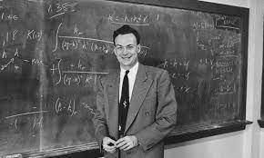
As well as scientific content…
To cover a range of topics and skills
e.g.
Standing Waves
Capacitor Behaviour
Stretching a Wire
Free Fall
Resistivity
Thermodynamics
Magnetic fields
As well as the main content of the course there are also 12 core practical activities to be carried out and written up.
Hopefully it won’t be a shock to you that the A-Level Physics course is very heavily mathematical. At least 40% of the exams will be mathematical but you can expect this to be regularly more. The standard is “at least” GCSE higher maths but in places goes a little further.

Slide 11
Transition from GCSE
Grade 6 in Science/Physics at GCSE
Demands at A-level are high and very skills based – like your GCSE (required practical work and data!)
Maths demand – 40% (algebra, graphs, geometry, logs and exponentials etc.)
Independent learning, extra reading
4 periods + study time – where you are expected to complete set work!

Slide 12
Preparing Over Summer!
Get equipped (we’ll do checks so no excuses)!
You won’t get a textbook but you can borrow one in your free periods if needed.
Revision guides bought need to be ‘AQA’
Transition work:
Induction booklet and tasks
Reading list
A large lever arch one is best!
Very Important!

Slide 13
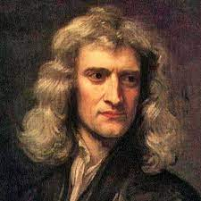
Transition work…
You have received an induction booklet with lots of basic information covering some of the skills you will need to master over the two year course. Please take a look at this over the summer.
In addition to this your actual transition work is a maths skills booklet. Having sharp maths skills is vital to success at A-Level physics and so by working through this booklet as best you can over the summer you will be giving yourself a head start, and making the transition to a difficult course a little less of a shock.
If you are taking A-Level Maths this will obviously help out your physics as well. Don’t worry if you’re not though as support will be given to you to get you confident!
It is important that you take these transition booklets seriously!

Slide 14
As well as the transition packs…
Wider reading around the subject helps you succeed at A level!
Over the summer why not put your phone down for a while and read a book (remember them)!
Six Easy Pieces (Richard Feynman)
Why does E-mc² ? (Brian cox and Jeff Forshaw)
Quantum Theory Cannot Hurt You (Marcus Chown)
Surely You’re Joking Mr Feynman (Richard Feynman)
In Search of Schrödinger’s Cat (John Gribbin)
If you insist on watching something then the BBC is always a good source of relevant and interesting Physics. Try the i-player for Brian cox and Jim al-Khalili documentaries that will ignite your passion for Physics!

Slide 15
Any Questions?

Slide 16
Quick Physics Quiz
Name a vector quantity?

Slide 17
Quick Physics Quiz
How many neutrons are in a Carbon-12 nucleus?

Slide 18
Quick Physics Quiz
In a sealed container of air, if I increase the temperature what else increases?

Slide 19
Quick Physics Quiz
True or False, there is no gravity in space, that’s why things float?

Slide 20
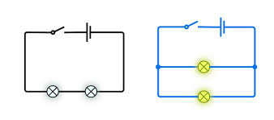
Quick Physics Quiz
All of the bulbs below are identical. The cells have p.d of 6 V. What are the p.ds across each of the bulbs?

Slide 21
Quick Physics Quiz
Sketch the magnetic field around a bar magnet.

Slide 22
Quick Physics Quiz
What turns in to a what in beta minus decay?

Slide 23
Quick Physics Quiz
A wave has frequency of 50 Hz and a wavelength of 2 m. Calculate its speed.

Slide 24
Quick Physics Quiz
What is the unit of electrical charge?

Slide 25
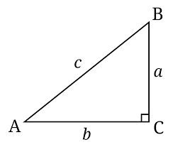
Quick WB Biology Quiz
a = 4cm, b = 3cm, c = ?

Slide 26
Quick WB Biology Quiz
Angle A = 30⁰, c = 10cm, a = ?, b = ?

