Slide 1
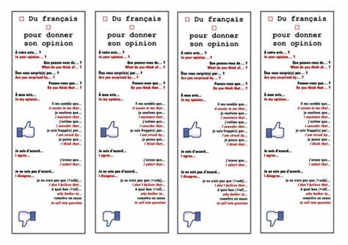
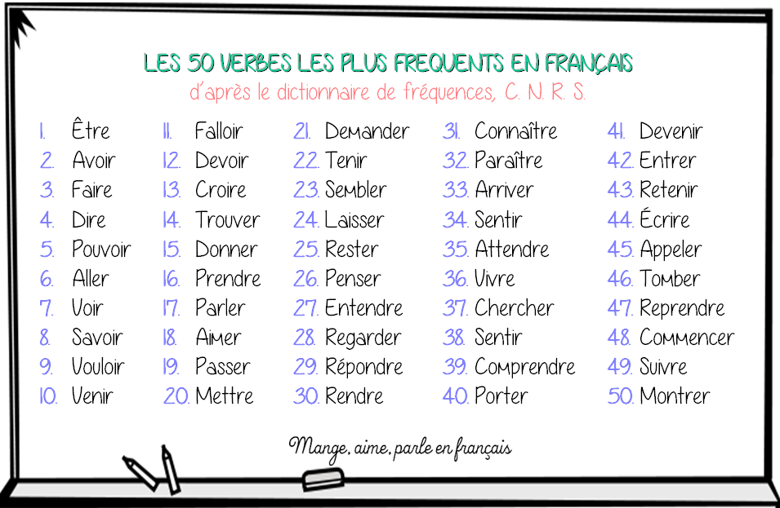
Q: A Level French- What should I be doing to help myself progress in the language, besides completing the set homework? A: Become a real Francophile! Mange, aime, parle …

Slide 2
You should …
Every day
Spend 15 minutes learning or reviewing vocabulary and/ or irregular verbs (use quizlet/ memrise/ make teach n test card packs/ look, cover, spell, check technique on paper/ make a learning fan/ make a tarsia/ use post- it notes around your bedroom/ ask someone to test you. Ensure nouns have genders, verbs are in infinitives with irregular past participles given and group related words together nouns,adjectives,adverbs.)
Listen to at least 10 minutes of news reports in French from France info radio (les informés from the previous day is useful)/ RFI (news in slowly spoken French)/watch France 24 t.v. en direct /a Tv5 Monde video/ a 1 jour 1 actu video whilst you travel to school/in a free period. Don’t worry, you may not understand every word but listen several times, focus on the pronunciation and cadence of the language, feel proud of what you DO understand.
Listen to a favourite song in French as you get ready in the morning. Start to sing along to the lyrics. No one is listening! (lyricstraining.com)
Twice a week
Choose and read one article in French in detail which interests you from 1 Jour 1 Actu/ 20 minutes (you can even download the “journal” from previous day for a long read)/ The Day and make a note of new vocabulary in your vocab notebooks/ vocab file section. The article does not have to relate to an A Level topic. Read for pleasure!
Once a week
Use You Tube to watch a “Frencheezi” clip on You Tube. Focus first on the French grammar clips, watch them twice then try to summarise the main points on paper. Make a list of the ones you have watched. Once you have finished all of the grammar ones, move onto the pronunciation advice clips, the intermediate vocab/ slang or the idioms clips.
Complete an interactive activity on Kerboodle resources from a topic you are covering at the moment in lessons.
Find and listen to a new song/ artist in French using You Tube, lyricstraining.com
Choose exercises to do or to redo from your grammar workbook related to a topic you have covered to date- mark it using the answers. Highlight the grammar rules info box, add new vocabulary to your notebook, review your mistakes.
Find a new French idiomatic phrase to add to a collection, however silly! Share with your class.
Look on our LSST MFL Twitter page and follow us. Look at what “les machin” or “verbe du jour” twitterers have come up with!
Once a module
Watch a Francophone film or an episode of a Francophone series. You can borrow a DVD from your teacher/ from U3 or use Netflix/ You Tube.
Make a Powerpoint and update with 5 cultural Francophone facts about the unit of work you are currently studying in lessons.
Follow a traditional French recipe (in French) and create an authentic French dish for the family! (recettes de cuisine traditionelle françaises)

