Slide 1
What were the most significant points in the lead-up to Bosworth?
Use the pages copied from the textbook included on this PowerPoint to complete the tasks on the next two slides.

Slide 2
Richard vs Henry!
Copy the table-put in the key points about who/what each side had. Highlight any areas which are advantageous to each side.
Why was the placing of the Stanleys so significant?
What was the turning point of the battle? Why was it a turning point?
What happened to Richard III’s supporters?
How does Michael Jones interpret Richard’s fateful charge?
Richard | Henry

Slide 3
Questions
Write down as many reasons as you can to show why Richard III was defeated at Bosworth.
How far was foreign support for Henry Tudor the most important reason for explaining why Henry Tudor won at Bosworth?

Slide 4
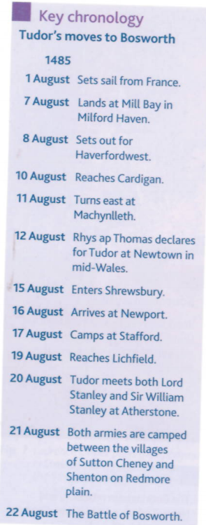
Textbook Excerpts:

Slide 5
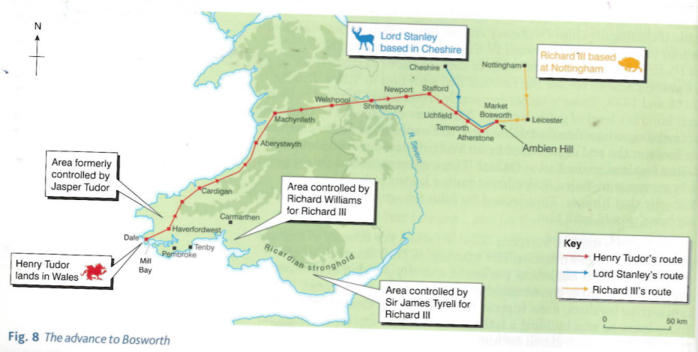
Textbook Excerpts:

Slide 6
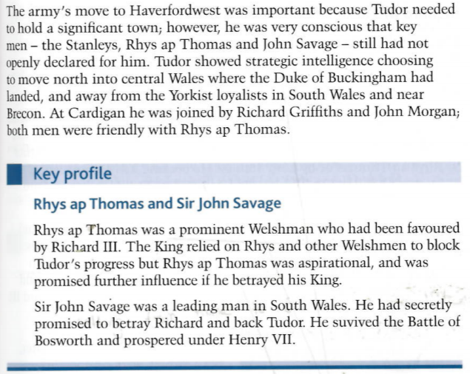
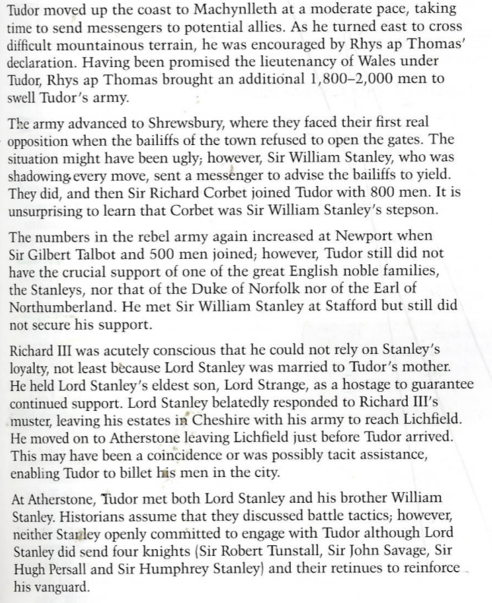
Textbook Excerpts:

Slide 7
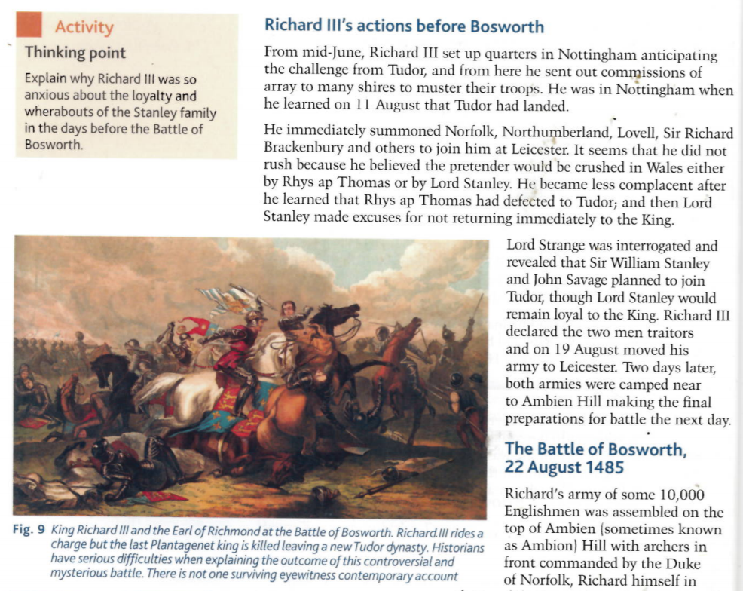
Textbook Excerpts:

Slide 8
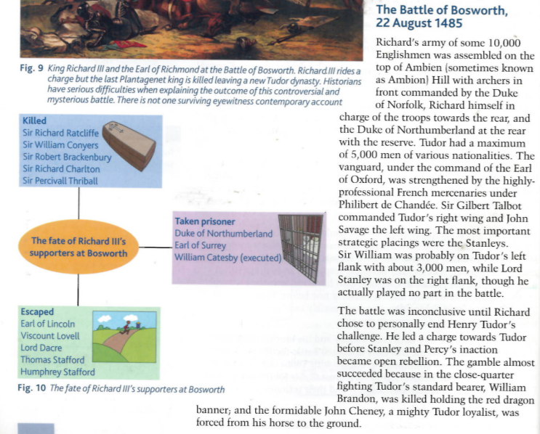
Textbook Excerpts:

Slide 9
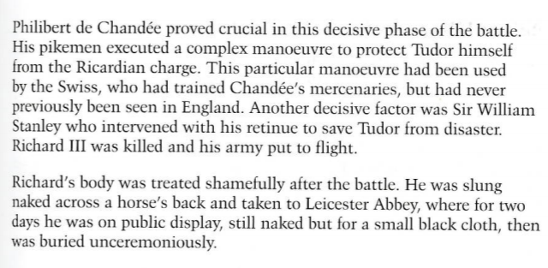
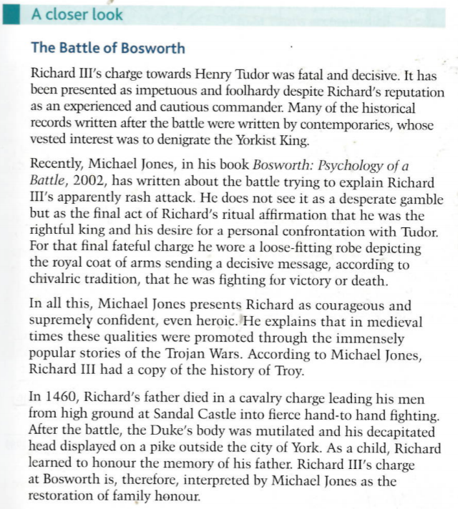
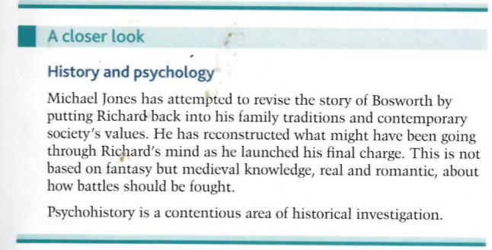
Textbook Excerpts:

Slide 10
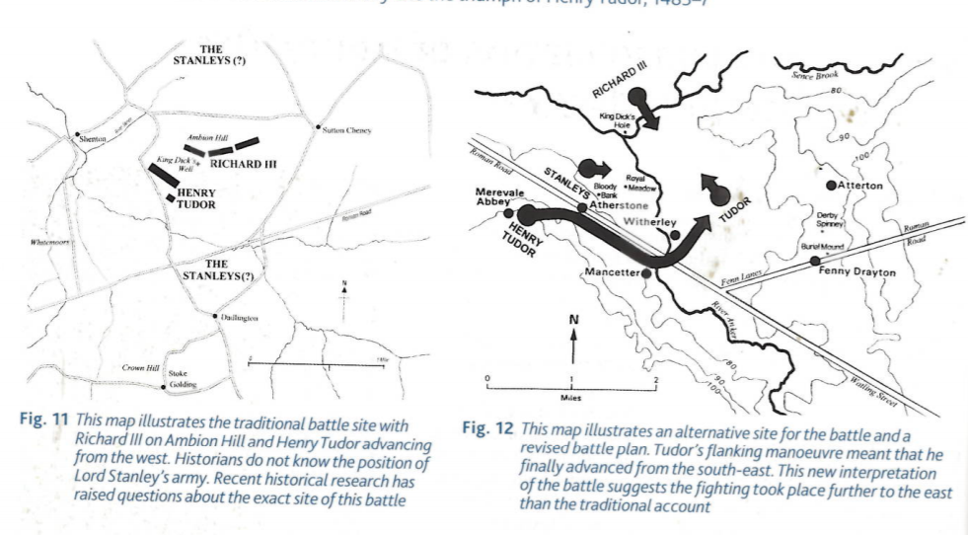
Textbook Excerpts:

Slide 11
Textbook Excerpts:

